Slide 1
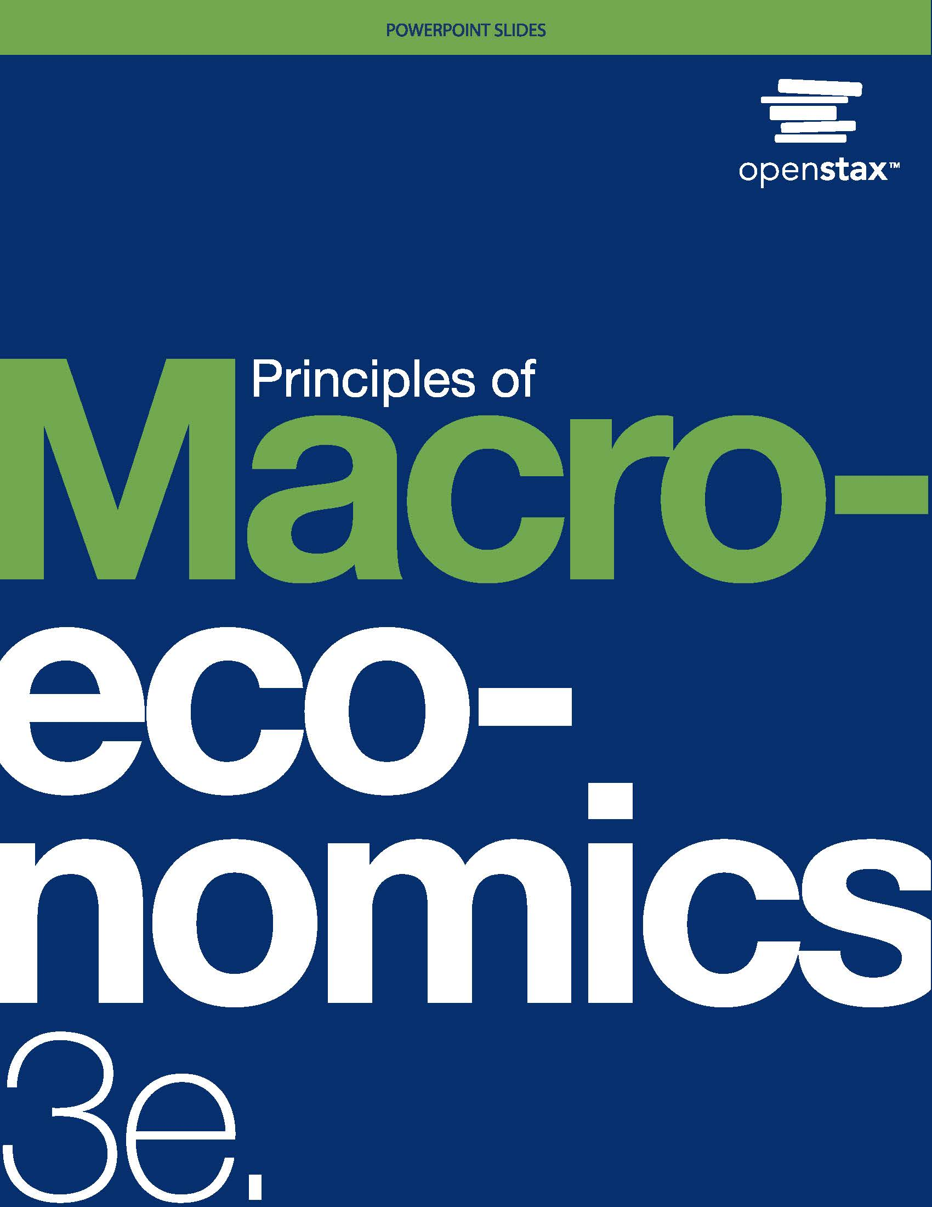
Principles of Macroeconomics 3e
Chapter 9 INFLATION
PowerPoint Image Slideshow

Slide 2
Ch.9 OUTLINE
9.1: Tracking Inflation
9.2: How to Measure Changes in the Cost of Living
9.3: How the U.S. and Other Countries Experience Inflation
9.4: The Confusion Over Inflation
9.5: Indexing and Its Limitations

Slide 3
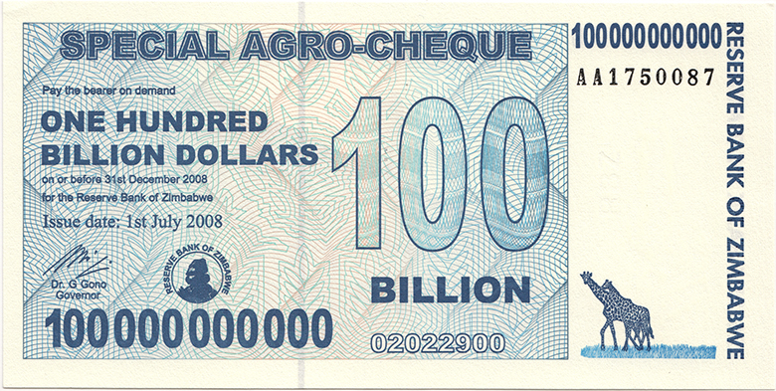
Big Bucks in Zimbabwe
This bill was worth 100 billion Zimbabwean dollars when issued in 2008.
There were even bills issued with a face value of 100 trillion Zimbabwean dollars. The bills had $100,000,000,000,000 written on them.
Unfortunately, they were almost worthless.
At one point, 621,984,228 Zimbabwean dollars were equal to one U.S. dollar.
Eventually, the country abandoned its own currency and allowed people to use foreign currency for purchases. (Credit: modification of "100 Billion Dollars" by Peat Bakke/Flickr, CC BY 2.0)

Slide 4
9.1 Tracking Inflation
Inflation - a general and ongoing rise in the level of prices in an entire economy.
Inflation does not refer to a change in relative (individual) prices.
There is pressure for prices to rise in most markets in the economy.
Basket of goods and services - a hypothetical group of different items, with specified quantities of each one meant to represent a “typical” set of consumer purchases.
Used to calculate the price level, by looking at how the prices of those items change over time.
Computed using a weighted average.
Base year - arbitrary year whose value (overall price level) serves as a standard with which to compare.

Slide 5
9.2 How to Measure Changes in the Cost of Living
Consumer Price Index (CPI) - a measure of inflation that U.S. government statisticians calculate based on the price level from a fixed basket of goods and services that represents the average consumer's purchases.
Inherent Difficulties of Using CPI:
Substitution bias - an inflation rate calculated using a fixed basket of goods over time tends to overstate the true rise in the cost of living, because it does not take into account that the person can substitute away from goods whose prices rise considerably.
Quality/new goods bias - inflation calculated using a fixed basket of goods over time tends to overstate the true rise in cost of living, because it does not account for improvements in the quality of existing goods or the invention of new goods.

Slide 6
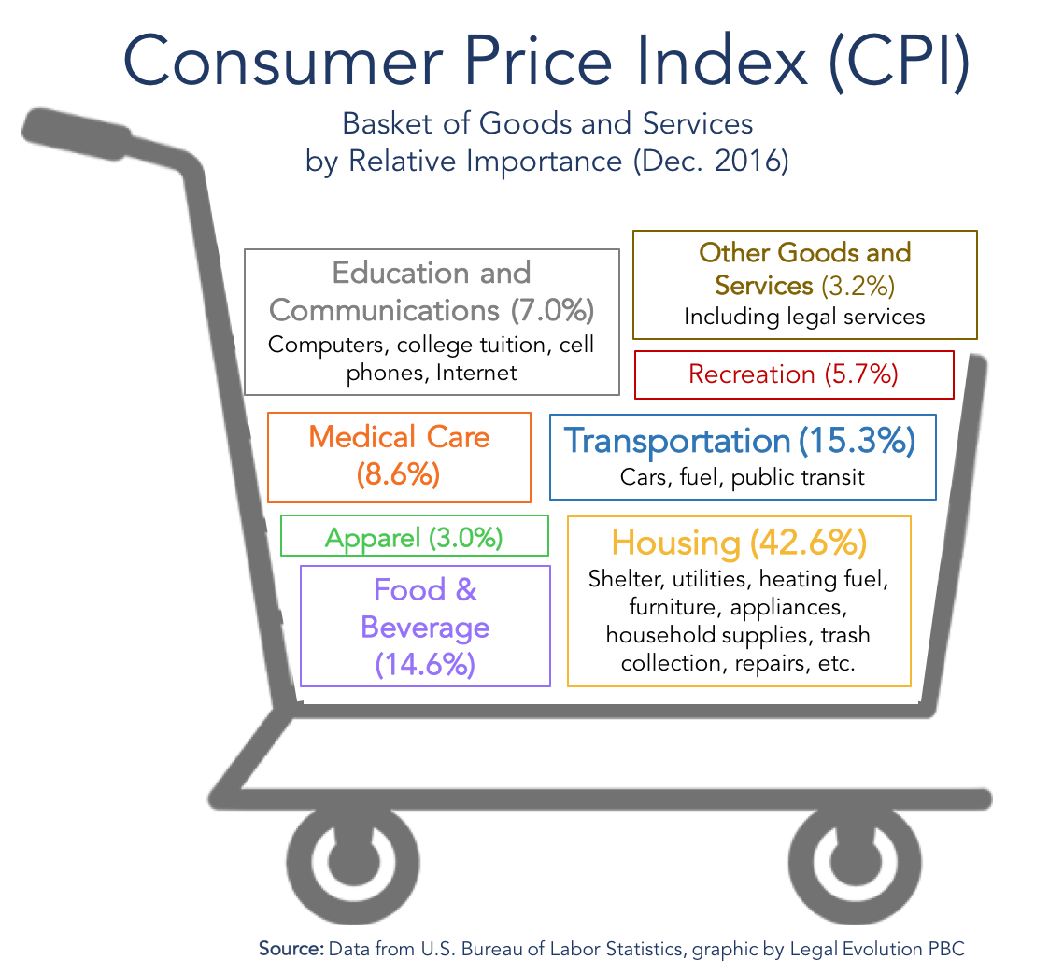

Slide 7
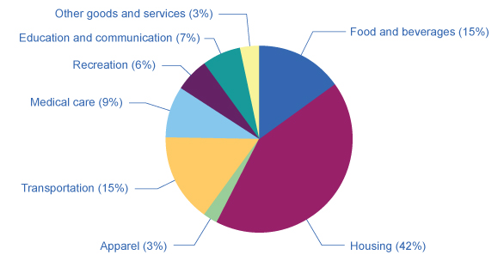
The Weighting of CPI Components
Of the eight categories used to generate the Consumer Price Index, housing is the highest at 42.4%.
The next highest category, food and beverage at 15.1%, is less than half the size of housing.
Other goods and services, and apparel, are the lowest at 3.2% and 2.7%, respectively. (Source: www.bls.gov/cpi)

Slide 8
The CPI and Core Inflation Index
Core inflation index - takes the CPI and excludes volatile economic variables, like energy and food prices.
Economists can have a better sense of the underlying trends in prices that affect the cost of living.
A preferred gauge from which to make important government policy changes.

Slide 9
Practical Solutions for the Substitution and the Quality/New Goods Biases
To allow for some substitution between goods, the Bureau of Labor Statistics uses alternative mathematical methods for calculating the CPI.
Updates the basket of goods behind the CPI more frequently, so that it can include new and improved goods more rapidly.
The substitution bias and quality/new goods bias has been somewhat reduced.
The rise in the CPI most likely overstates the true rise in inflation by only about 0.5% per year.

Slide 10
Additional Price Indices
Producer Price Index (PPI) - a measure of inflation based on prices paid for supplies and inputs by producers of goods and services.
Different industries, commodities, and stages of processing.
International Price Index (IPI)- a measure of inflation based on the prices of merchandise that are exported or imported.
Employment Cost Index (ECI)- a measure of inflation based on wages paid in the labor market.
GDP deflator - a measure of inflation based on the prices of all the GDP components (consumption, investment, government, exports minus imports).

Slide 11
9.3 How the U.S. and Other Countries Experience Inflation
Notable waves of U.S. inflation:
after World War I
after World War II
the 1970s
Deflation - severe negative inflation.
when most prices in the economy are falling.
Notable periods of U.S. deflation:
following the 1920-21 recession
the Great Depression of the 1930s
Hyperinflation - an outburst of high inflation that often occurs (although not exclusively) when economies shift from a controlled economy to a market-oriented economy
The closest the United States has ever reached hyperinflation was during the 1860–1865 Civil War, in the Confederate states.

Slide 12
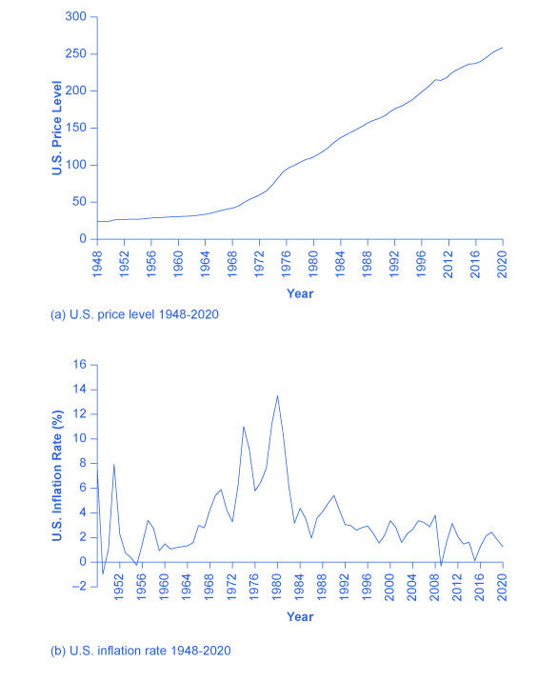
U.S. Price Level and Inflation Rates
(a) The U.S. price level rose relatively little over the first half of the twentieth century. Afterwards, it gradually increases until about 1973, then increases more rapidly through the remainder of the 1970s and beyond, with periodic dips, until 2016, when it reached around 240.
(b) In 1948, the graph starts out with inflation at almost 7%, goes up and down periodically, with peaks in the 1940s and the 1970s, until settling to around 1.2% in 2020.

Slide 13
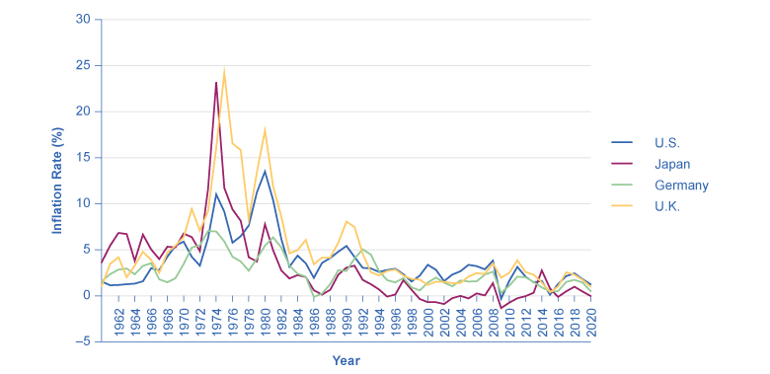
Countries with Relatively Low Inflation Rates, 1961–2020
This chart shows the annual percentage change in consumer prices compared with the previous year’s consumer prices in the United States, the United Kingdom, Japan, and Germany.

Slide 14
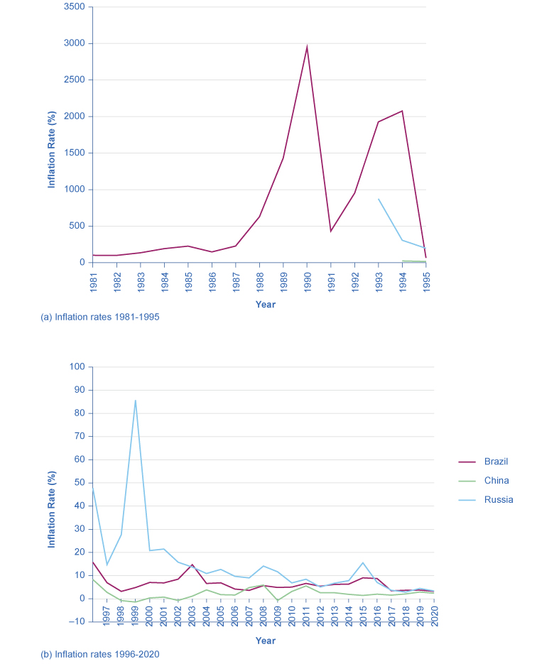
Countries with Relatively High Inflation Rates, 1981–2021
These charts show inflation rates in Brazil, China, and Russia.
(a) Of these, Brazil and Russia experienced hyperinflation at some point between the mid-1980s and mid-1990s.
(b) Though not as high, China and Nigeria also had high inflation rates in the mid-1990s. Even though their inflation rates have come down over the last two decades, several of these countries continue to see significant inflation rates. (Sources: http://research.stlouisfed.org/fred2/series/FPCPITOTLZGBRA; http://research.stlouisfed.org/fred2/series/CHNCPIALLMINMEI; http://research.stlouisfed.org/fred2/series/FPCPITOTLZGRUS)

Slide 15
9.4 The Confusion Over Inflation
If other economic variables (prices, wages, and interest rates) do not move in sync with inflation, or if they adjust for inflation only after a time lag, then inflation can cause three types of problems:
unintended redistributions of purchasing power
blurred price signals
difficulties in long-term planning

Slide 16
Unintended Redistributions of Purchasing Power
People are hurt by inflation when:
they are holding cash
they have financial asset investments where the nominal return does not keep up with inflation (also can be exacerbated by taxes)
wages lag behind inflation
wage adjustments are often somewhat sticky and occur only once or twice a year.
they are a retiree receiving a private company defined pension
Ordinary people can sometimes benefit from inflation.
A borrower paying a fixed interest rate can end up better off, because they can repay their loans in dollars that are worth less than originally expected.

Slide 17
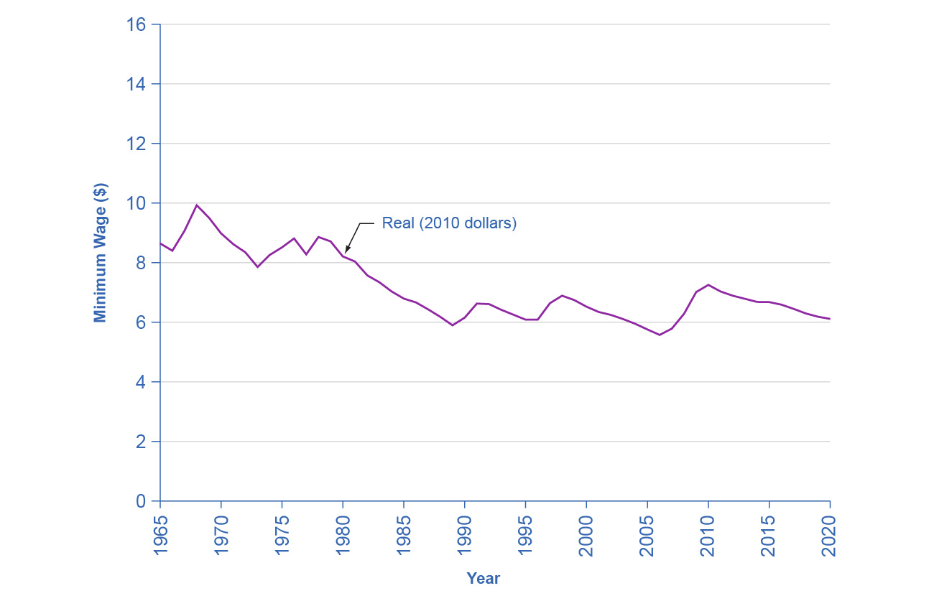
U.S. Minimum Wage and Inflation
After adjusting for inflation, the federal minimum wage dropped about 30 percent from 1965 to 2020, even though the nominal figure climbed from $1.40 to $7.25 per hour.
Increases in the minimum wage between 2008 and 2010 kept the decline from being worse - as it would have been if the wage had remained the same as it did from 1997 through 2007. (Sources: http://www.dol.gov/whd/minwage/chart.htm; http://data.bls.gov/cgi-bin/surveymost?cu)

Slide 18
Blurred Price Signals
Prices are the messengers in a market economy, conveying information about conditions of demand and supply.
Inflation blurs those price messages.
Inflation means that we perceive price signals more vaguely, like static on the radio .
When the levels and changes of prices become uncertain, businesses and individuals find it harder to react to economic signals.

Slide 19
Problems of Long-Term Planning
Inflation can make long-term planning difficult.
Planning for retirement in unknown future dollar levels.
More time spent by businesses finding ways of profiting from inflation vs. less time spent on productivity, innovation, or quality of service.

Slide 20
9.5 Indexing and Its Limitations
Indexed - a price, wage, or interest rate is adjusted automatically for inflation.
Examples of indexing arrangements in private markets:
Cost-of-living adjustments (COLAs) - a contractual provision that wage increases will keep up with inflation.
Adjustable-rate mortgage (ARM) - a type of loan a borrower uses to purchase a home in which the interest rate varies with market interest rates.

Slide 21
Indexing in Government Programs
Examples of indexing arrangements in government programs:
The U.S. income tax code is designed so income levels where higher tax rates kick in are indexed to rise automatically with inflation.
The level of Social Security benefits increases each year along with the Consumer Price Index.
An indexed increase in the Social Security tax base accompanies the indexed rise in the benefit level.
U.S. government offers indexed bonds promising to pay a certain real rate of interest above whatever inflation rate occurs.

